Slide 1

Notes:
Cover Slide

Slide 2


SIMPLIFICATIONS

Slide 3
Simplification
Simplification means to find out a final answer for a complex calculation.
Basic Topics on which Simplification is based on:
BODMAS rules
Approximation
Percentage
Squares
Cubes

Slide 4
Question: 01
A man has Rs.480 in the denominations of one-rupee notes, five-rupee notes and ten-rupee notes. The number of notes of each denomination is equal. What is the total number of notes that he has?
45
60
75
90
Answer: D

Slide 5
Explanation:
Let number of notes of each denomination be x
Then x + 5x + 10x = 480
16x = 480
x = 30.
Hence, total number of notes = 3x = 90

Slide 6
Question: 02
There are two examination rooms A and B. If 10 students are sent from A to B, then the number of students in each room is same. If 20 candidates are sent from B to A, then the number of students in A is double the number of students in B. The number of students in room A is:
20
80
100
200
Answer: C

Slide 7
Explanation:
Let the number of students in rooms A and B be x and y respectively.
Then, x - 10 = y + 10
x - y = 20 .... (i)
and x + 20 = 2(y - 20)
x - 2y = -60 .... (ii)
Solving (i) and (ii) we get: x = 100 , y = 80.
The required answer A = 100.

Slide 8
Question: 03
The price of 10 chairs is equal to that of 4 tables. The price of 15 chairs and 2 tables together is Rs. 4000. The total price of 12 chairs and 3 tables is:
Rs. 3500
Rs. 3740
Rs. 3840
Rs. 3900
Answer: D

Slide 9
Explanation:
Let the cost of a chair and that of a table be Rs. x and Rs. y respectively.
Then, 10x = 4y
Y = 5/2 x
15x + 2y = 4000
15x + 2 x 5/2 x = 4000
20x = 4000
x = 200.
y= (5/2 * 200) = 500
Hence, the cost of 12 chairs and 3 tables = 12x + 3y
Rs. (2400 + 1500) = Rs. 3900.

Slide 10
Question: 04
If a - b = 3 and a² + b² = 29, find the value of ab.
10
12
15
18
Answer: A

Slide 11
Explanation:
2ab = (a² + b²) - (a - b)²
= 29 - 9 = 20
ab = 10.

Slide 12
Question: 05
The price of 2 sarees and 4 shirts is Rs. 1600. With the same money one can buy 1 saree and 6 shirts. If one wants to buy 12 shirts, how much shall he have to pay?
1200
2400
3600
4800
Answer: B

Slide 13
Explanation:
Let the price of a saree and a shirt be Rs. x and Rs. y respectively.
Then, 2x + 4y = 1600 .... (i)
and x + 6y = 1600 .... (ii)
Divide equation (i) by 2, we get the below equation.
=> x + 2y = 800. --- (iii)
Now subtract (iii) from (ii)
x + 6y = 1600 (-)
x + 2y = 800
----------------
4y = 800
----------------

Slide 14
Explanation:
Therefore, y = 200.
Now apply value of y in (iii)
=> x + 2 x 200 = 800
=> x + 400 = 800
Therefore x = 400
Solving (i) and (ii) we get x = 400, y = 200
Cost of 12 shirts = Rs. (12 x 200) = Rs. 2400.

Slide 15
Question: 06
A sum of Rs. 1360 has been divided among A, B and C such that A gets ⅔ of what B gets and B gets ¼ of what C gets. B's share is:
Rs. 120
Rs. 160
Rs. 240
Rs. 300
Answer: C

Slide 16
Explanation:
Let C's share = Rs. x
Then, B's share = Rs. x/4 , A's share = Rs. ( ⅔ * x/4 ) = Rs. x/6
x/4 + x/6 + x = 1360
17x/12 = 1360
X = (1360 * 12) / 17 = Rs. 960.
Hence, B's share = Rs.(960/4) = Rs. 240.

Slide 17
Question: 07
One-third of Rahul's savings in National Savings Certificate is equal to one-half of his savings in Public Provident Fund. If he has Rs. 1,50,000 as total savings, how much has he saved in Public Provident Fund?
Rs. 30,000
Rs. 50,000
Rs. 60,000
Rs. 90,000
Answer: C

Slide 18
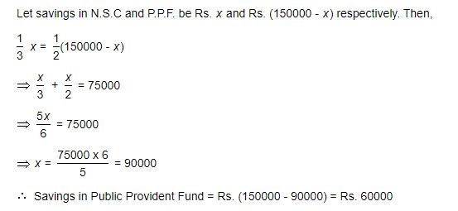
Explanation:

Slide 19
Question: 08
A fires 5 shots to B's 3 but A kills only once in 3 shots while B kills once in 2 shots. When B has missed 27 times, A has killed
30 Birds
60 Birds
72 Birds
90 Birds
Answer: A

Slide 20
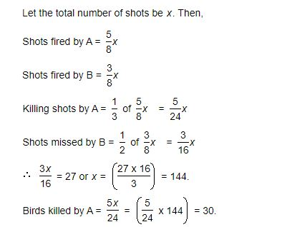
Explanation:

Slide 21
Question: 09
Eight people are planning to share equally the cost of a rental car. If one person withdraws from the arrangement and the others share equally the entire cost of the car, then the share of each of the remaining persons increased by:
1/7
6/8
1/9
7/8
Answer: A

Slide 22
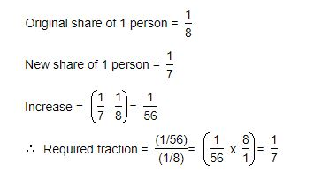
Explanation:

Slide 23
Question: 10
To fill a tank, 25 buckets of water is required. How many buckets of water will be required to fill the same tank if the capacity of the bucket is reduced to two-fifth of its present?
10
32
62.5
75
Answer: C

Slide 24
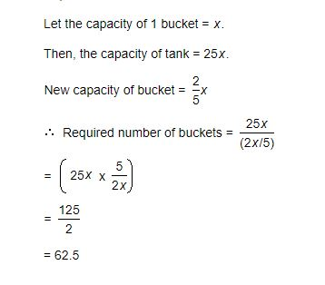
Explanation:

Slide 25
Question: 11
In a regular week, there are 5 working days and for each day, the working hours are 8. A man gets Rs. 2.40 per hour for regular work and Rs. 3.20 per hours for overtime. If he earns Rs. 432 in 4 weeks, then how many hours does he work for?
160
175
180
195
Answer: B

Slide 26
Explanation:
Suppose the man works overtime for x hours.
Now, working hours in 4 weeks = (5 x 8 x 4) = 160.
160 x 2.40 + x 3.20 = 432
3.20x = 432 - 384 = 48
x = 15.
Hence, total hours of work = (160 + 15) = 175.

Slide 27
Question: 12
Free notebooks were distributed equally among children of a class. The number of notebooks each child got was one-eighth of the number of children. Had the number of children been half, each child would have got 16 notebooks. Total how many notebooks were distributed?
256
432
512
640
Answer: C

Slide 28
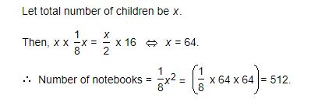
Explanation:

Slide 29
Question: 13
A man has some hens and cows. If the number of heads be 48 and the number of feet equals 140, then the number of hens will be:
22
23
24
26
Answer: D

Slide 30
Explanation:
Let the number of hens be x and the number of cows be y.
Then, x + y = 48 .... (i)
and 2x + 4y = 140 x + 2y = 70 .... (ii)
Solving (i) and (ii) we get: x = 26, y = 22.
The required answer = 26.

Slide 31
Question: 14
David gets on the elevator at the 11th floor of a building and rides up at the rate of 57 floors per minute. At the same time, Albert gets on an elevator at the 51st floor of the same building and rides down at the rate of 63 floors per minute. If they continue travelling at these rates, then at which floor will their paths cross?
19
28
30
37
Answer: C

Slide 32
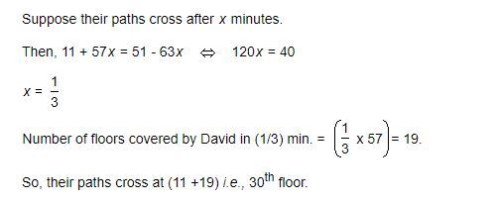
Explanation:

Slide 33
Question: 15
Solve 5(1/2) + 6(1/2) - 8(1/4)
2(3/ 4)
3((3/ 4)
2(1/ 4)
2(2/ 4)
Answer: B

Slide 34
Explanation:
5(1/2) + 6(1/2) - 8(1/4) = (5+6-8) + ((1/2) + (1/2) - (1/4)) = 3(3/4)

Slide 35








/ethnuscodemithra
Ethnus Codemithra
/ethnus
/code_mithra
THANK YOU
https://learn.codemithra.com/
codemithra@ethnus.com
+91 7815 095 095
+91 9019 921 340

